Slide 1


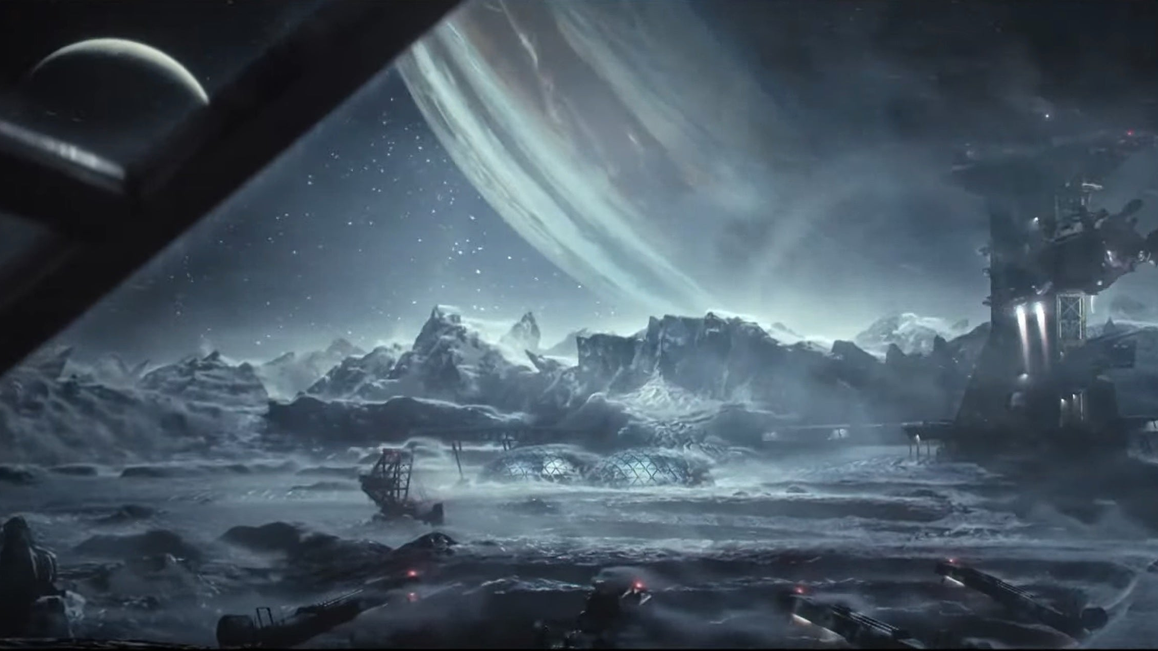
Game Concept
An FPS wave survival game set in a research facility on a frozen Planetoid Titan, where the players will take control of the last survivor of a containment breach.
Using limited and repurposed weapons the survivors must survive the exponential waves of alien monsters and defend the main console until the self-destruct is ready to be activated.
Once it has been activated, the players must escape the facility at its most dangerous before time runs out.
Claustrophobic overwhelming numbers.
Testing the players skill at out-maneuvering threats and fighting back against exponential danger.
Unusual Weaponry
Working with a repurposed gravity manipulator and sentry gun, the player can swap between knockback and mobility, or locking into place to rain gunfire on the threats.
Scavenge supplies
During the waves, the player must gather scrap to replenish defenses and upgrade their weapons to gain an edge in surviving.

Slide 2
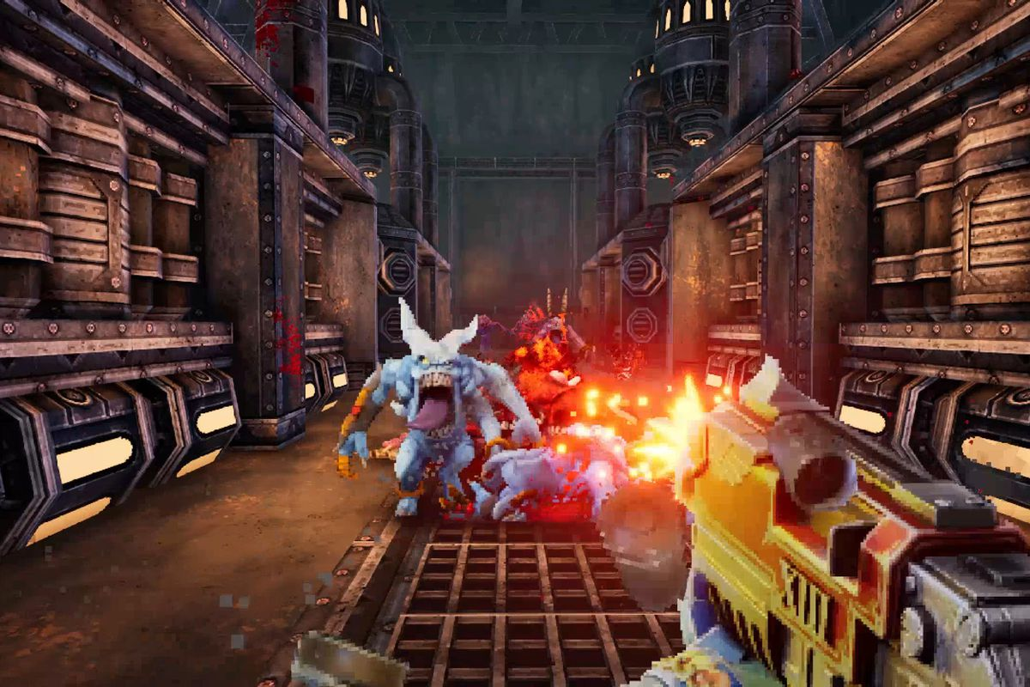
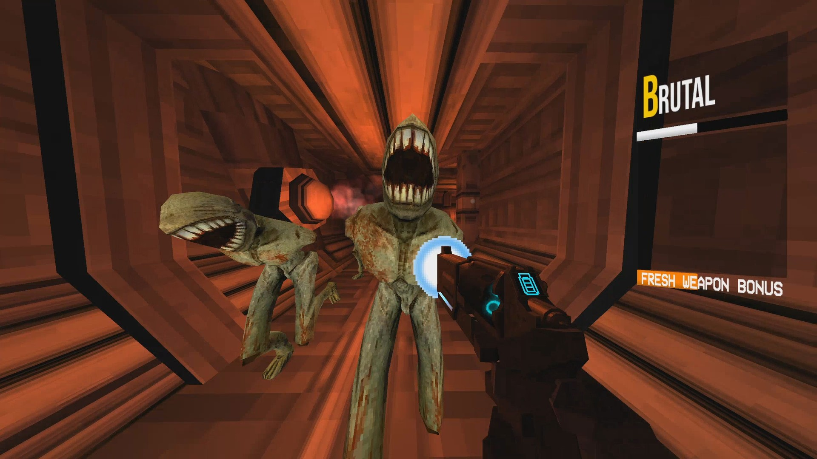
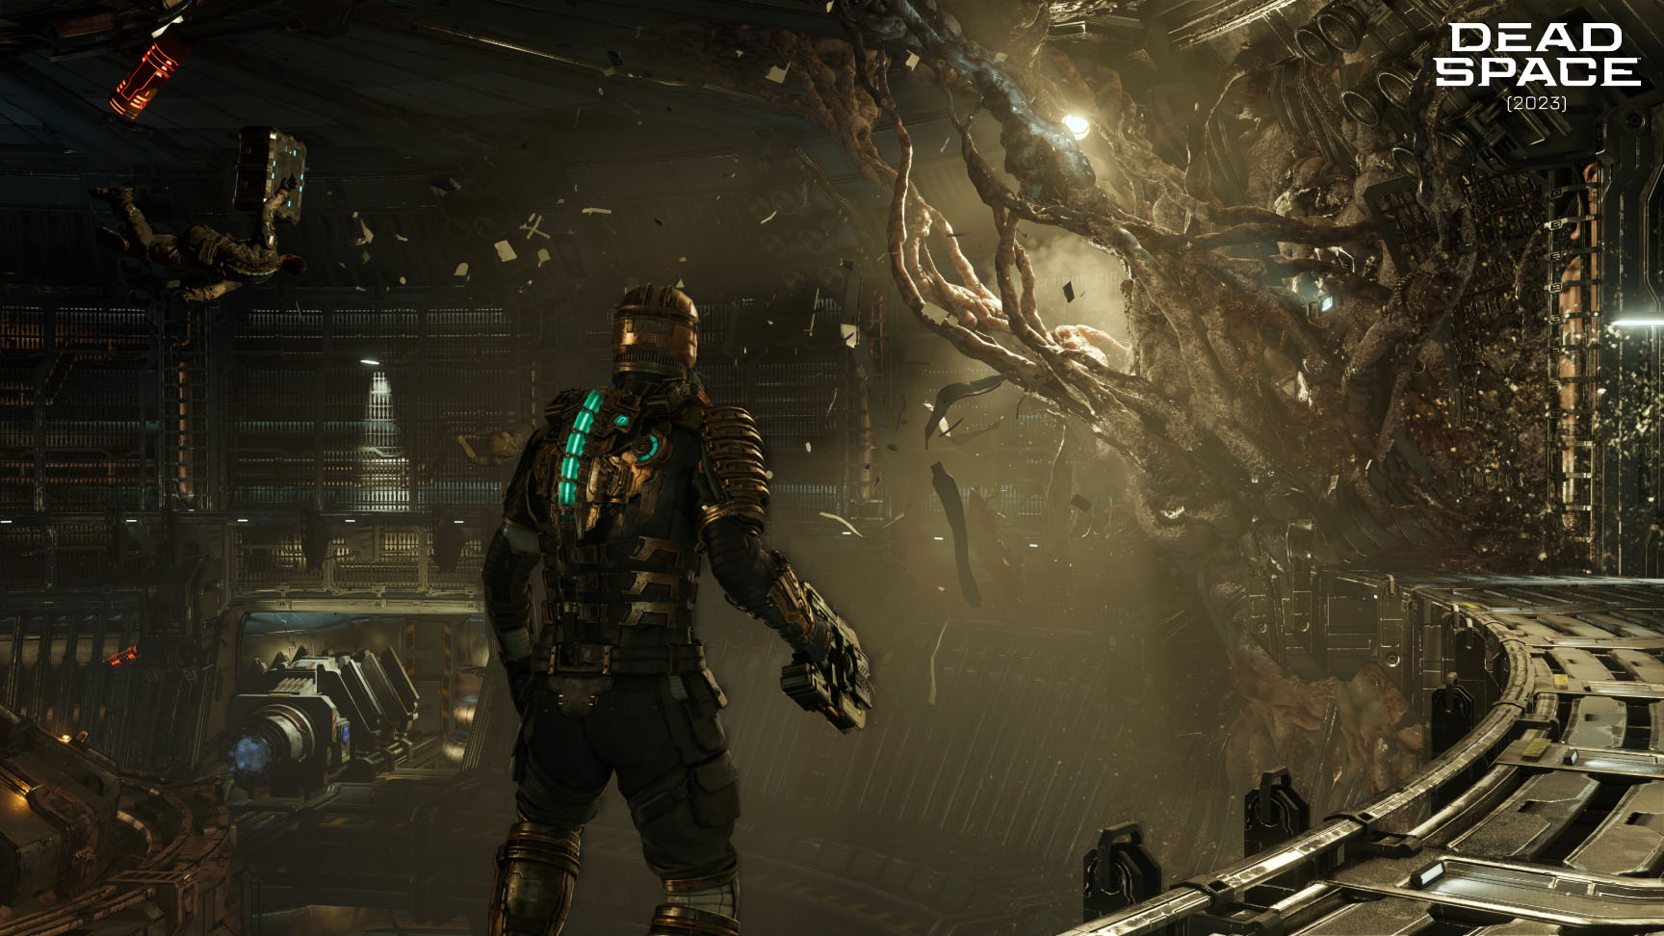
Existing media
The concept for this game draws inspiration from:
Doom/ULTRAKILL/Warhammer 40k Boltgun (FPS movement and gameplay)
Deep Rock Galactic (Art Style and Environment)
Left 4 Dead (hordes and overwhelming numbers)
Dead Space (aesthetics and environment)
Vampire Survivors (overwhelming numbers and player limitations)

Slide 3
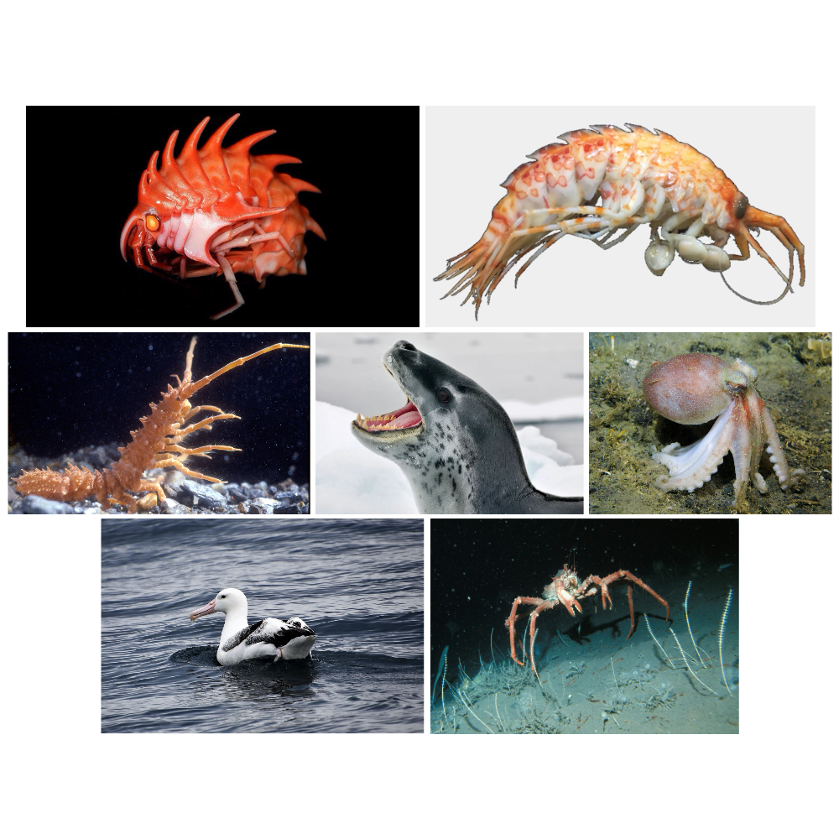
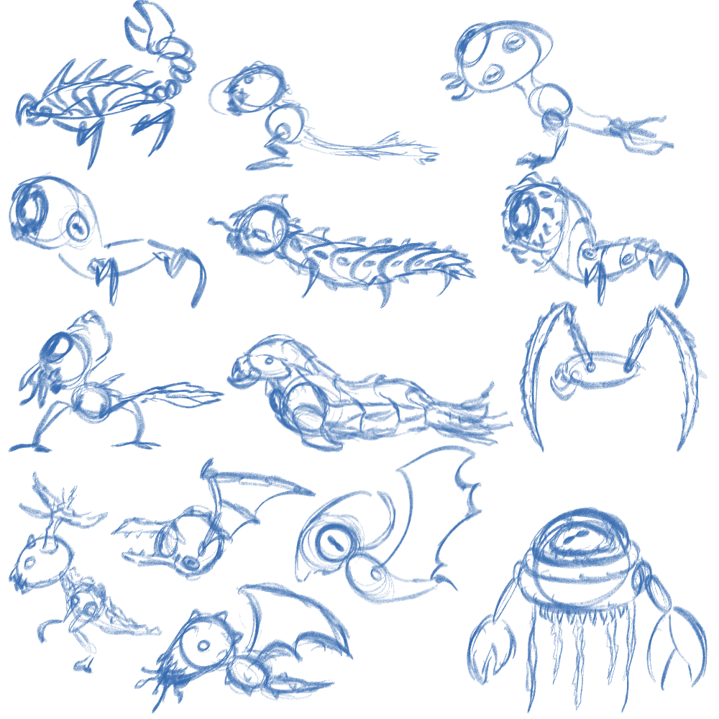
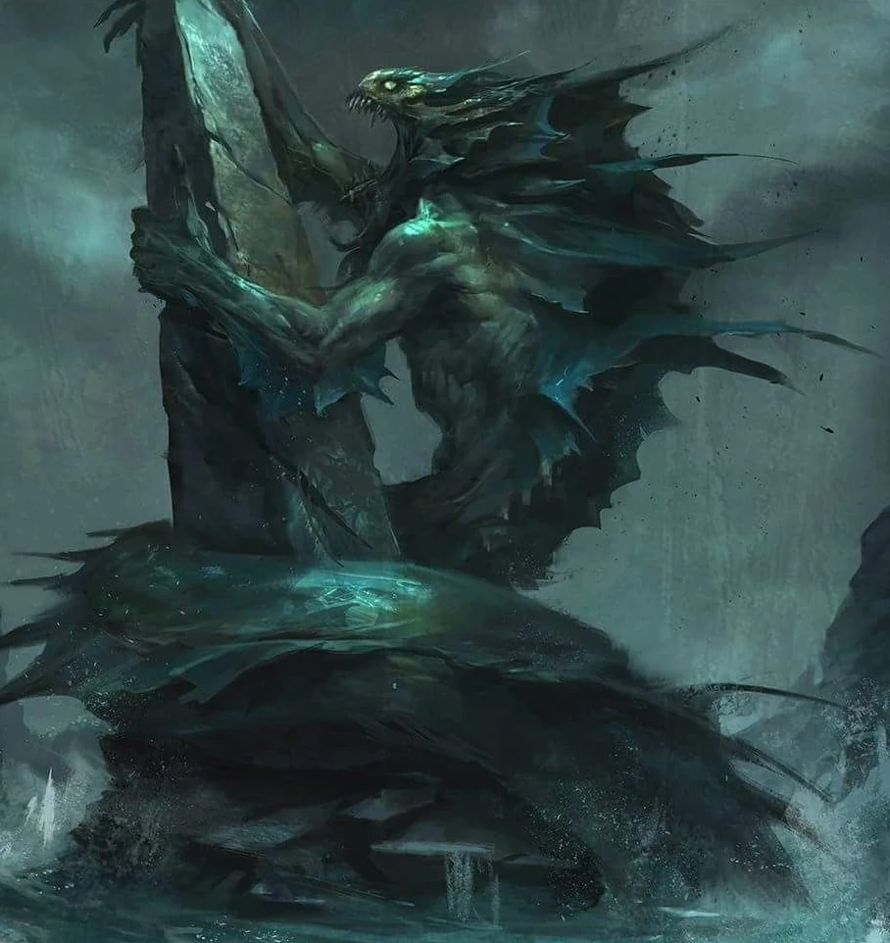
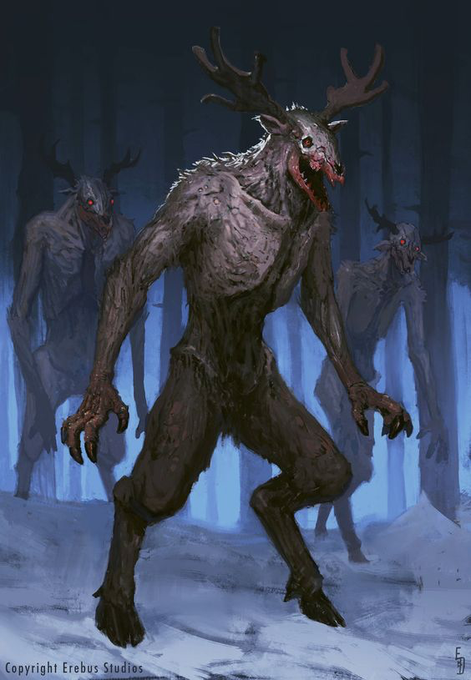
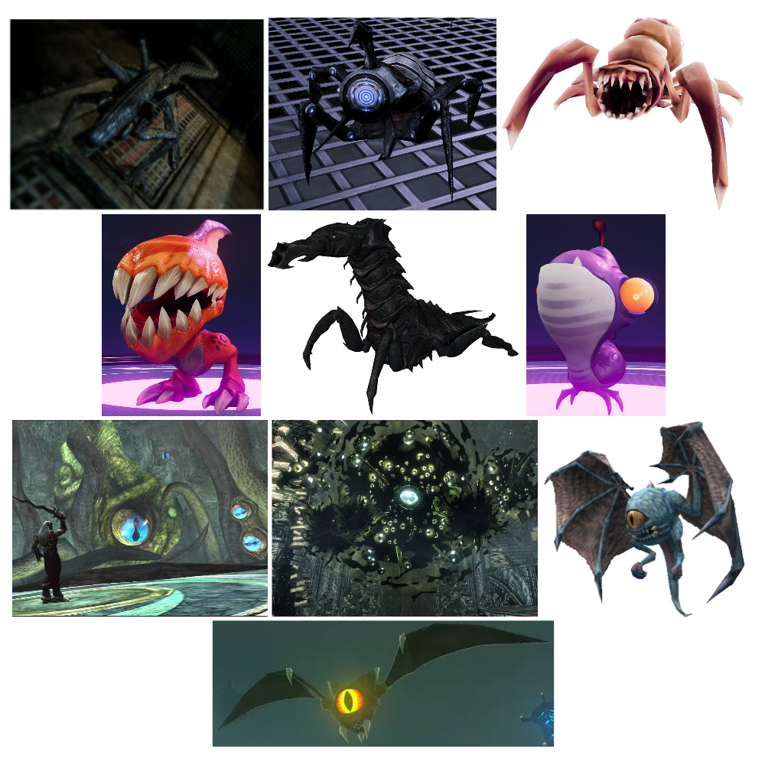
2D Concept Art & Small Enemies
Moodboard of Animal Influences
Lovecraftian
Moodboard of Game Enemies
Mythology:
Wendigo

Slide 4
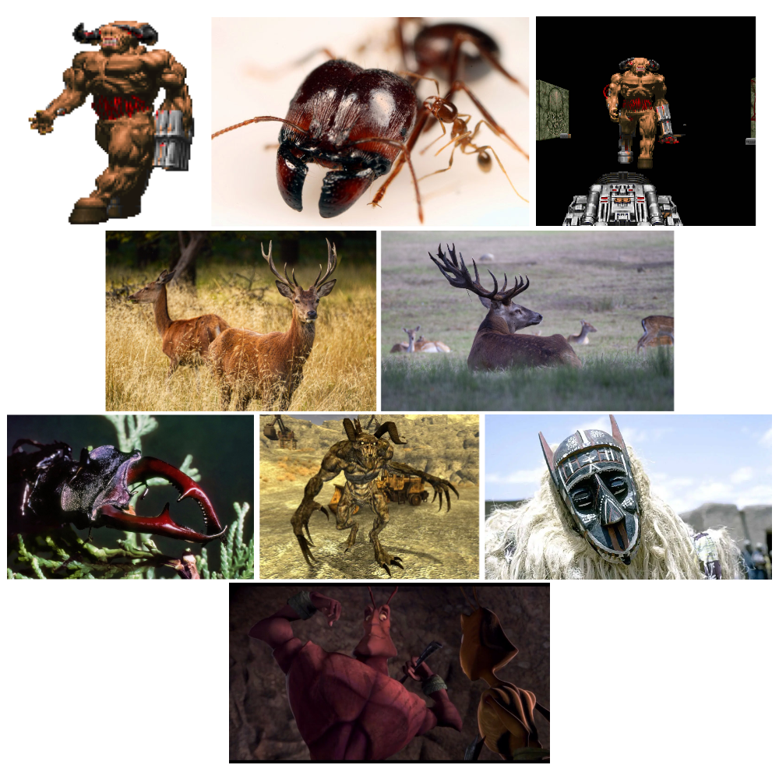
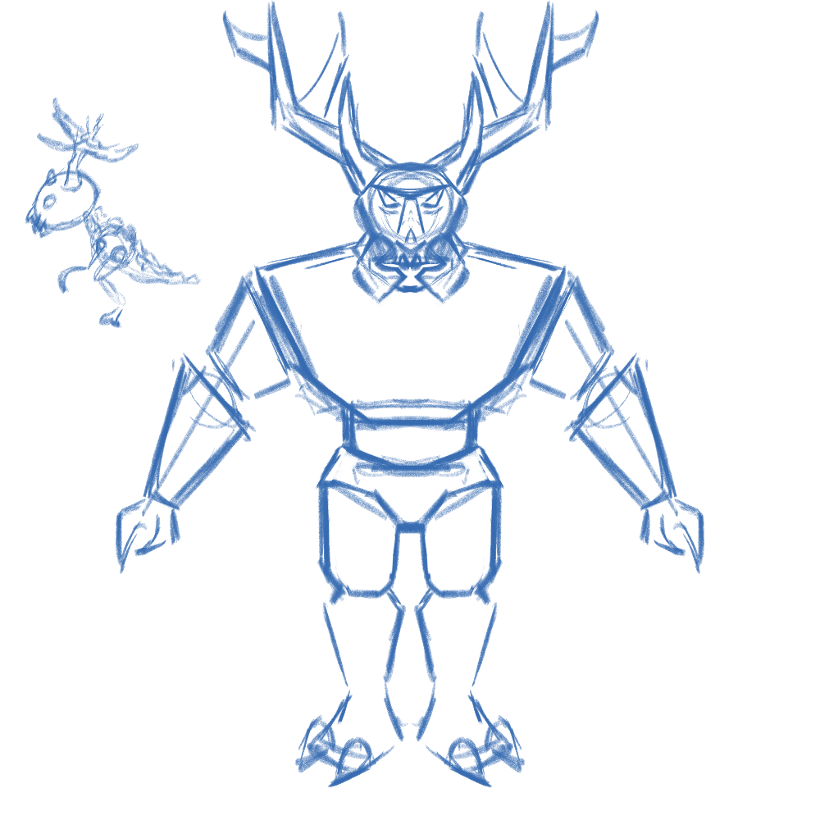
Character & Big Enemies
Big Enemies will prioritize attacking the Main Console, the point that the player must protect.
Slower
Larger Health Pool
Deals a lot more Damage
Can rally horde
The existence of these enemies forces the player to return to the defense objective and attack the oncoming enemies rather than just being able to run, thus keeping player engagement the game loop.

Slide 5
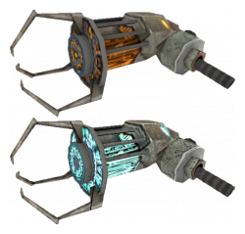

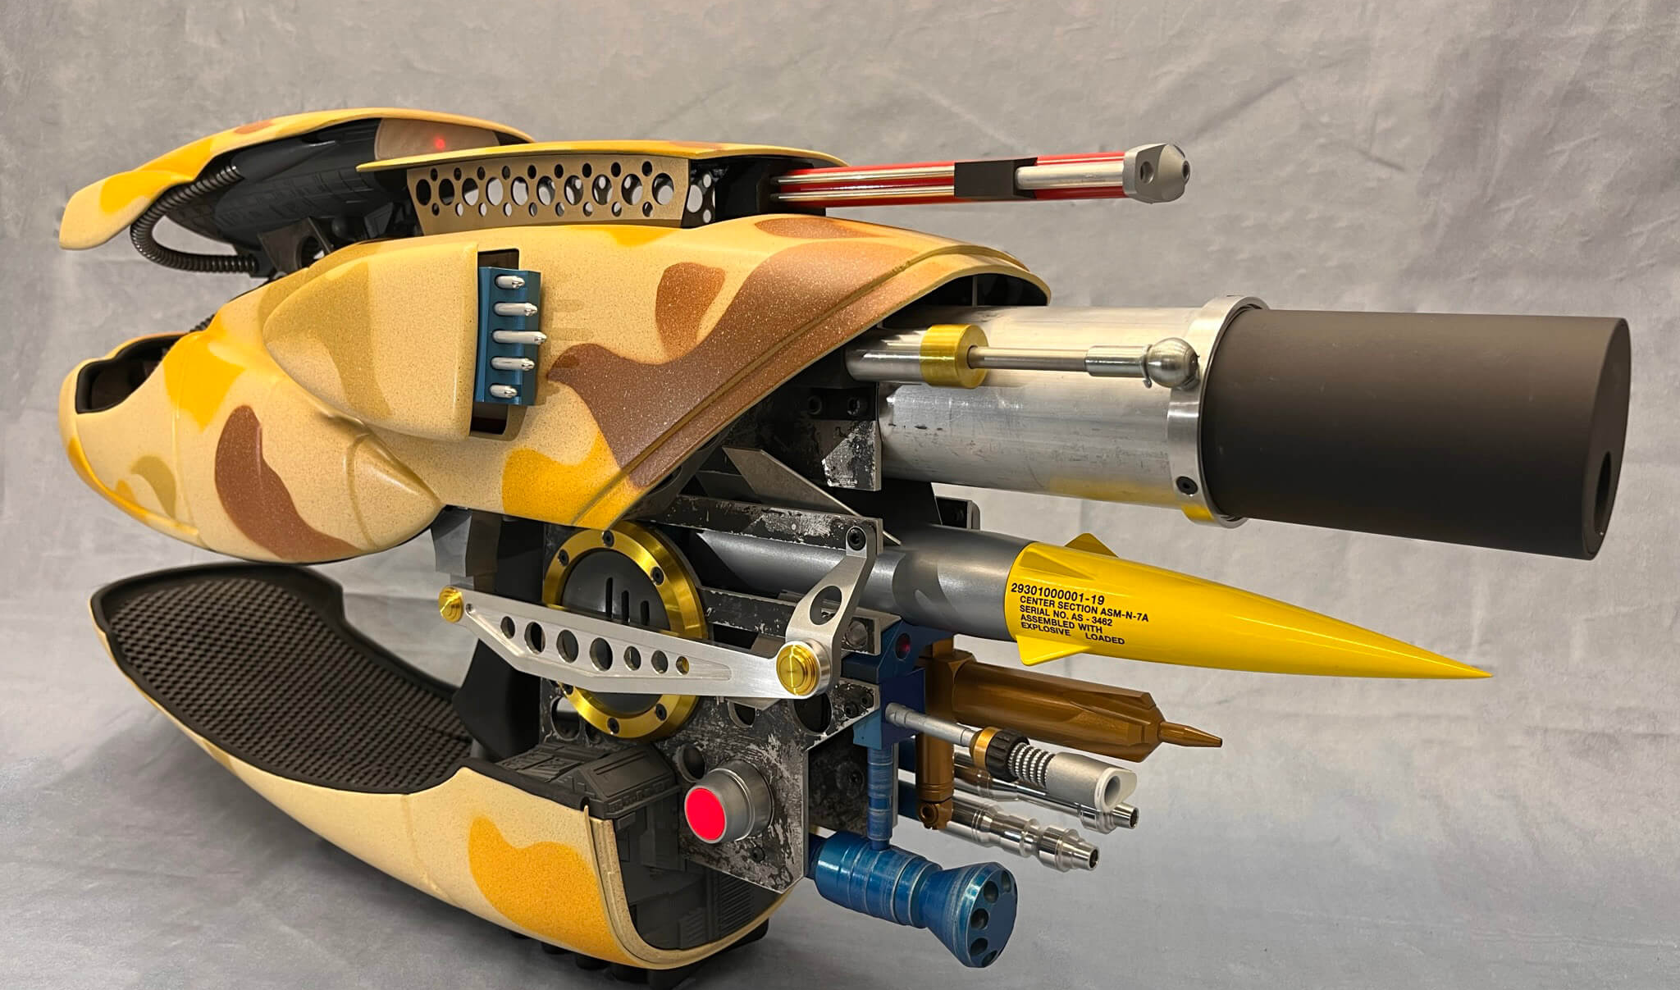
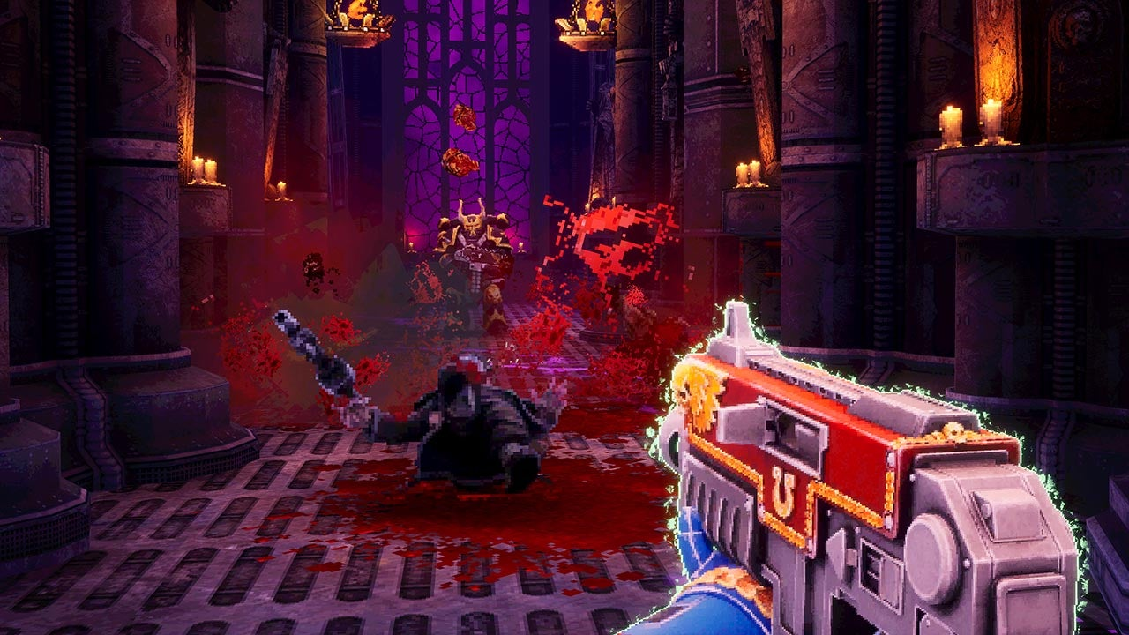
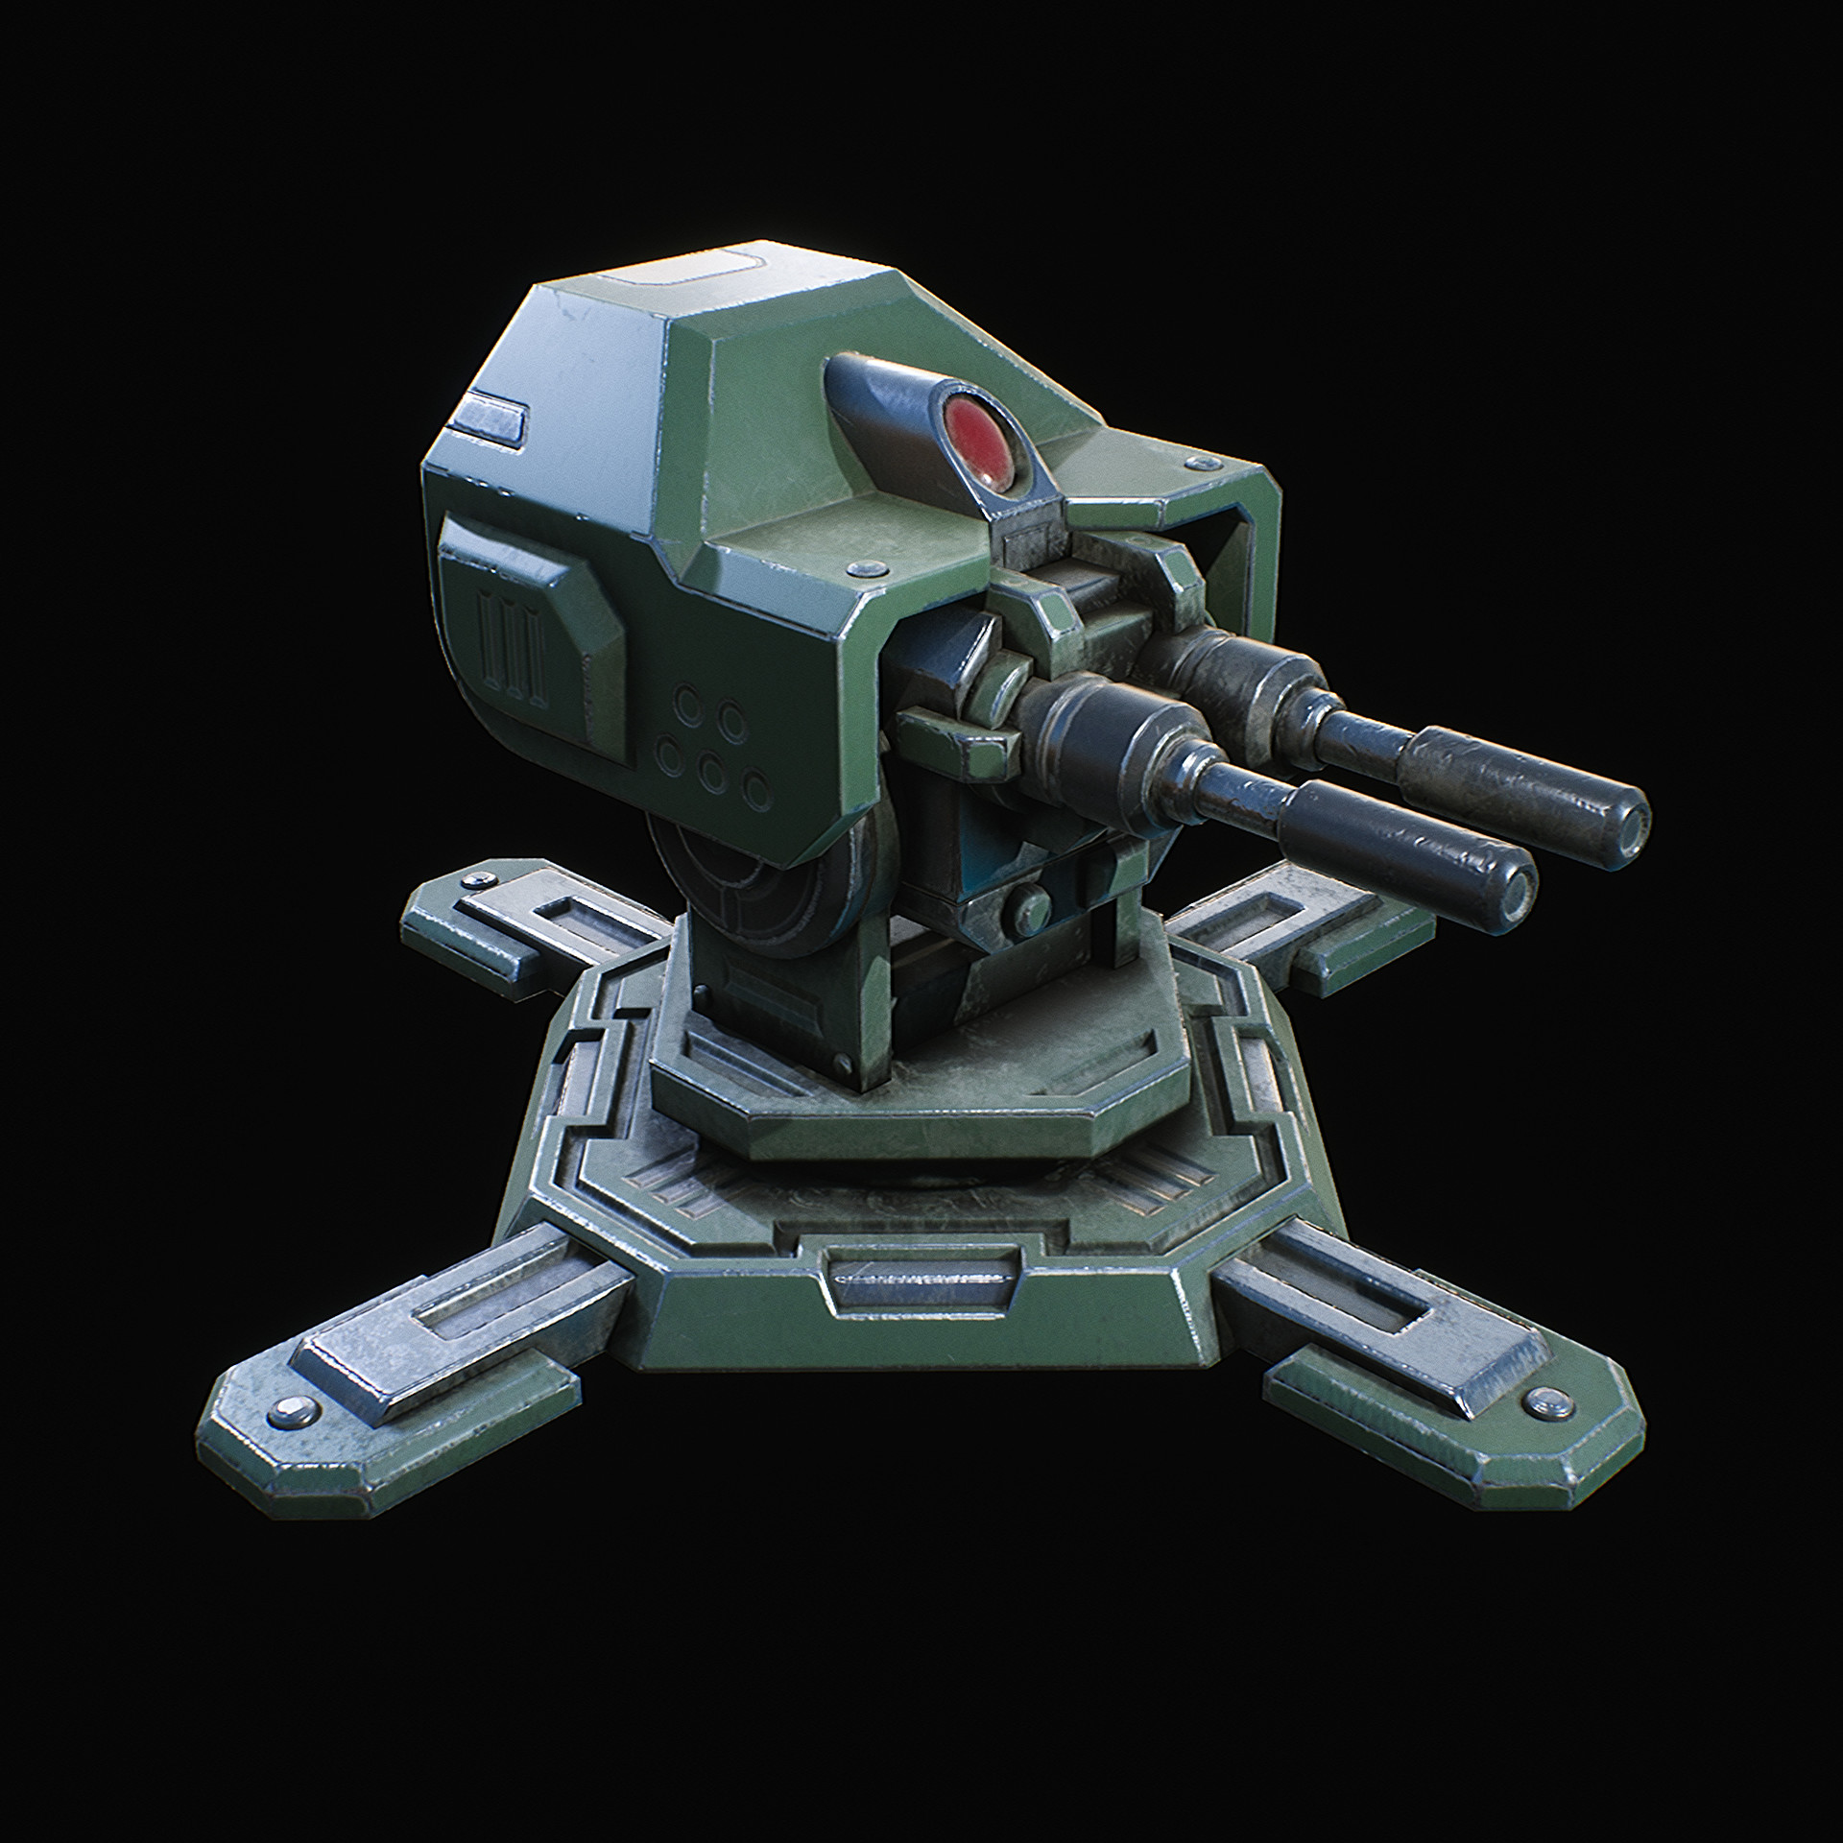
Weapons, Items, Mob Drops

Slide 6
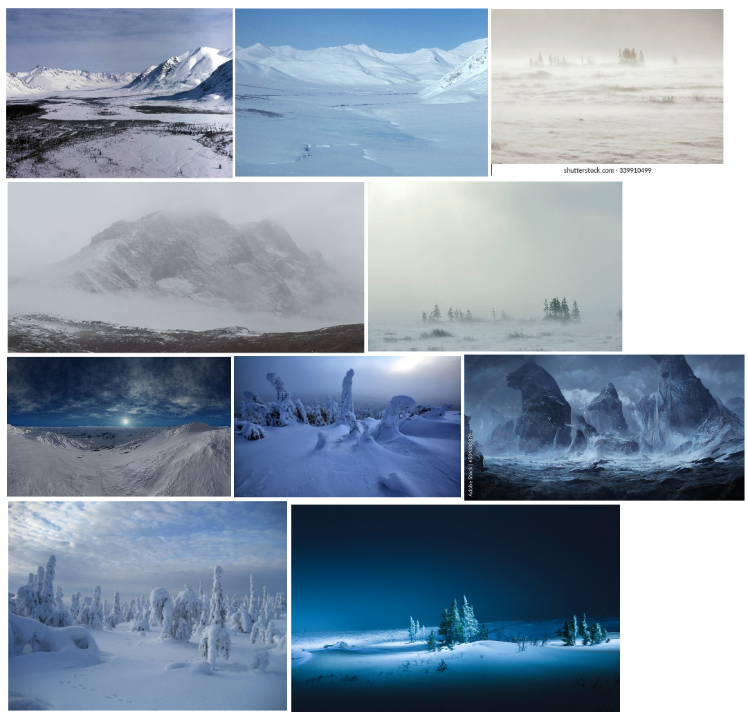
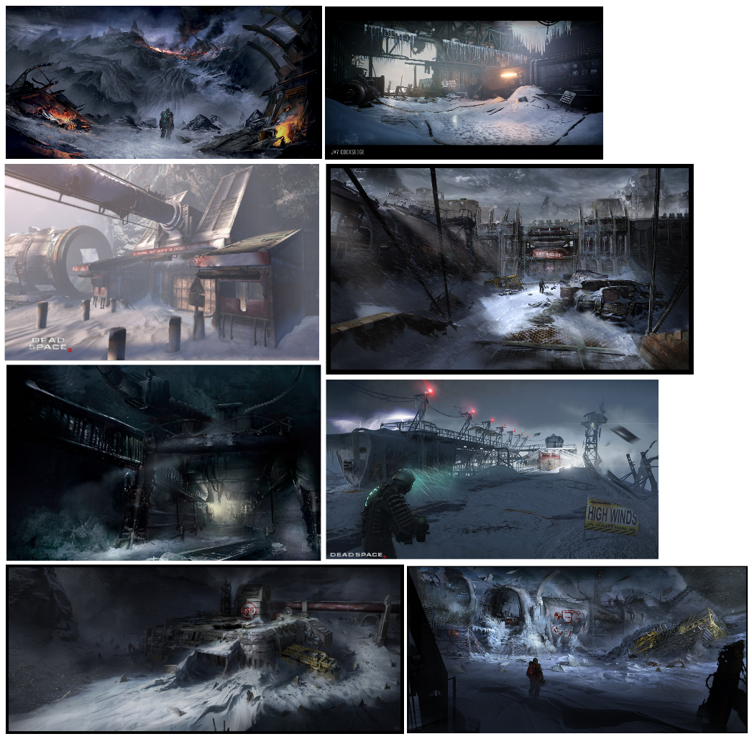
Environment – Style Inspiration
Outside Facility
Dead Space 3
Research Images for a Tundra Environment

Slide 7
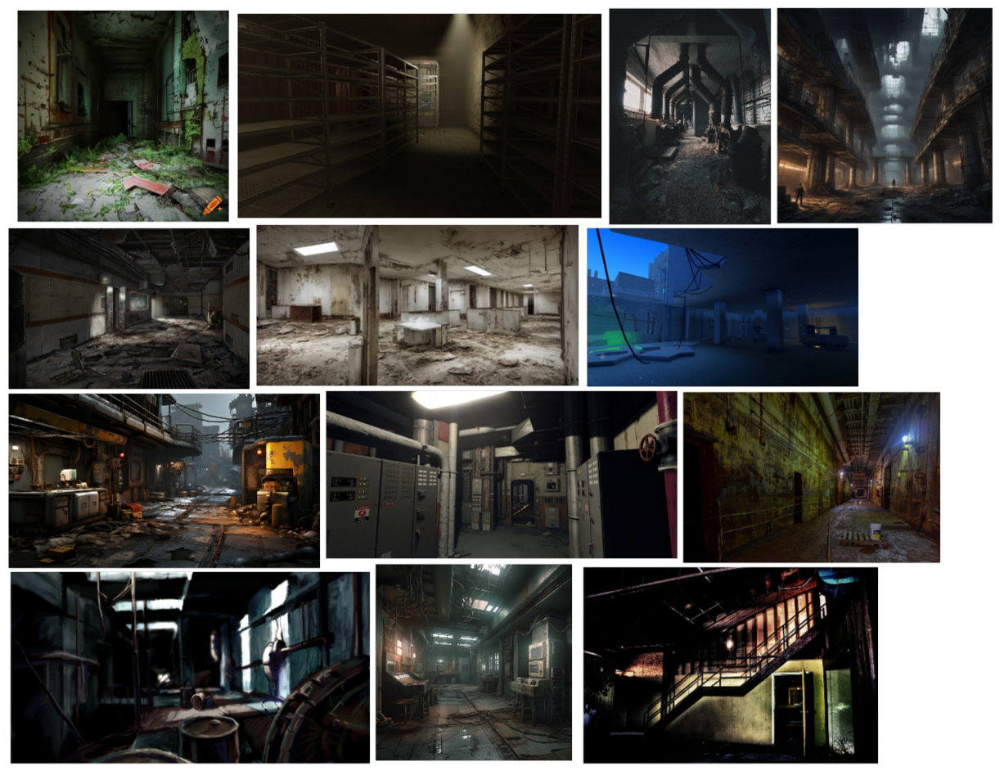
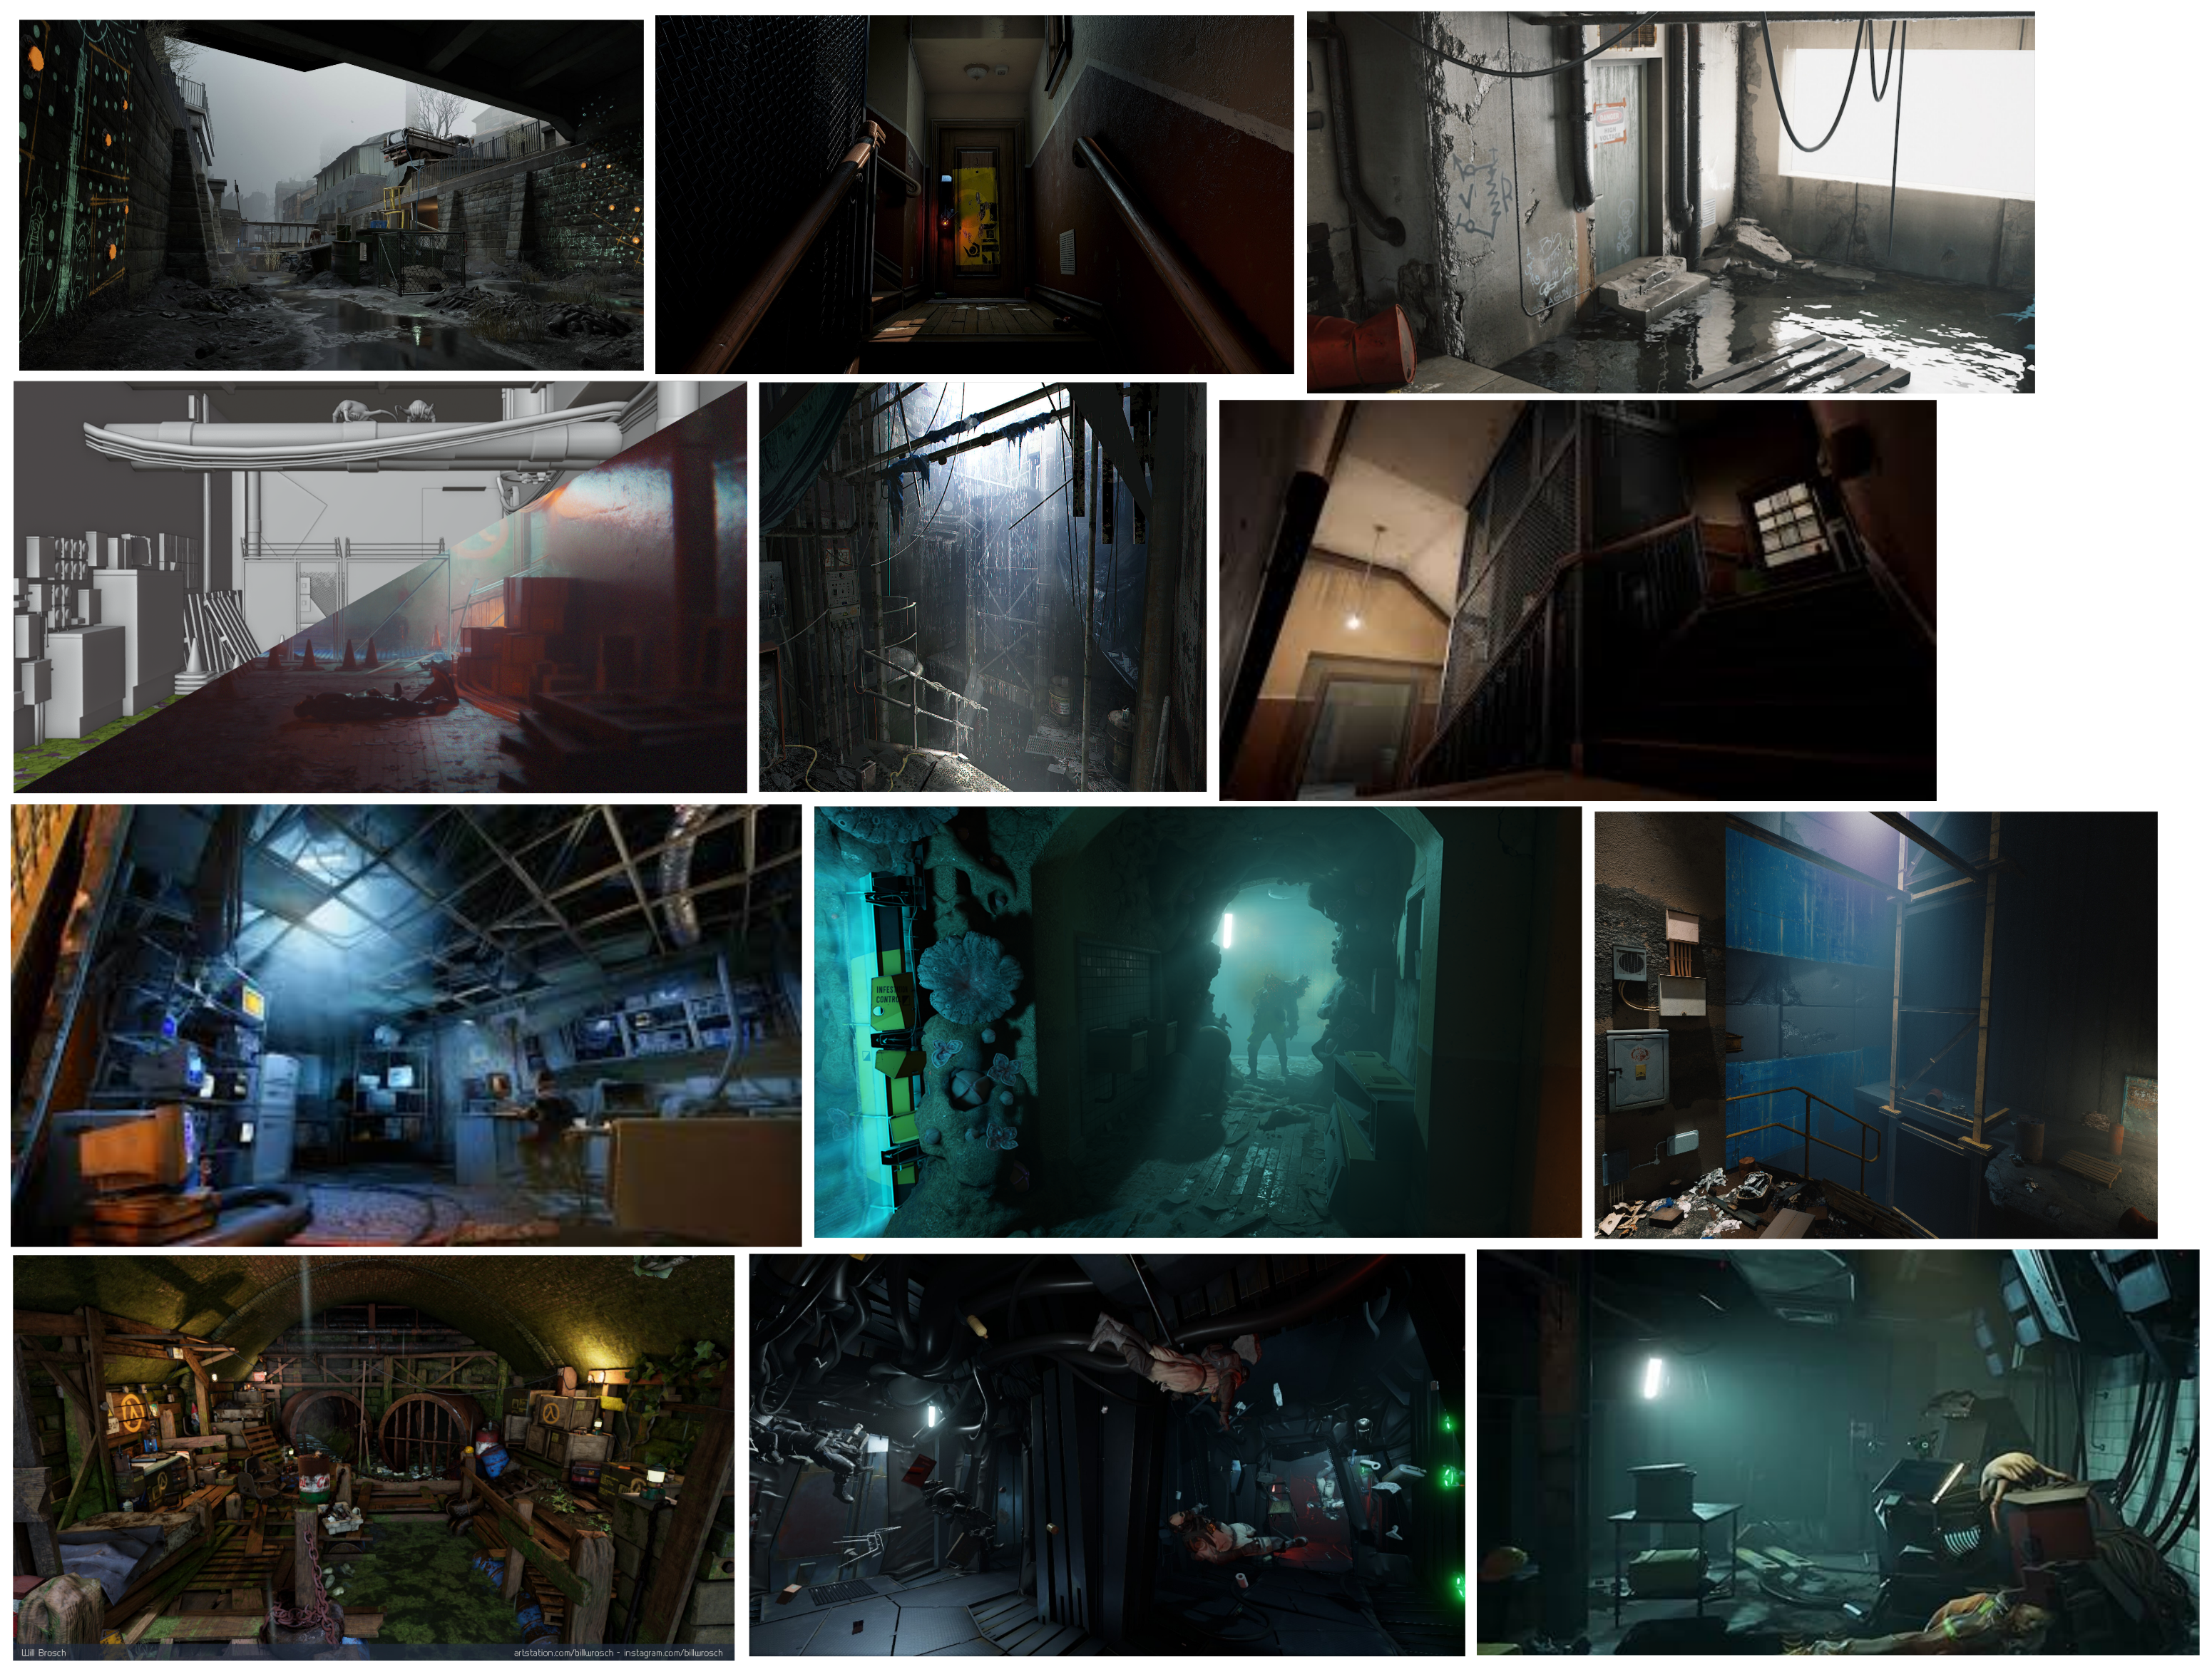
Environment – Style Inspiration
Inside Facility
Half Life
Research Images for an Abandoned Facility

Slide 8
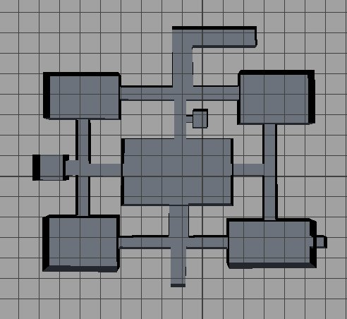
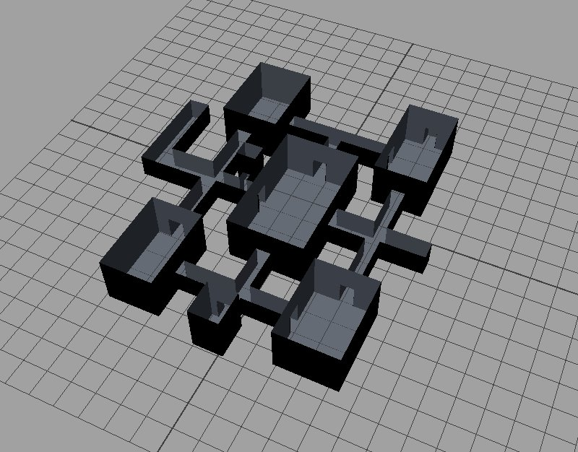
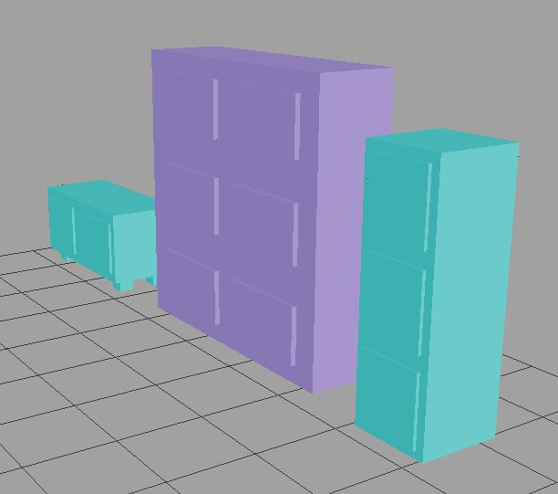
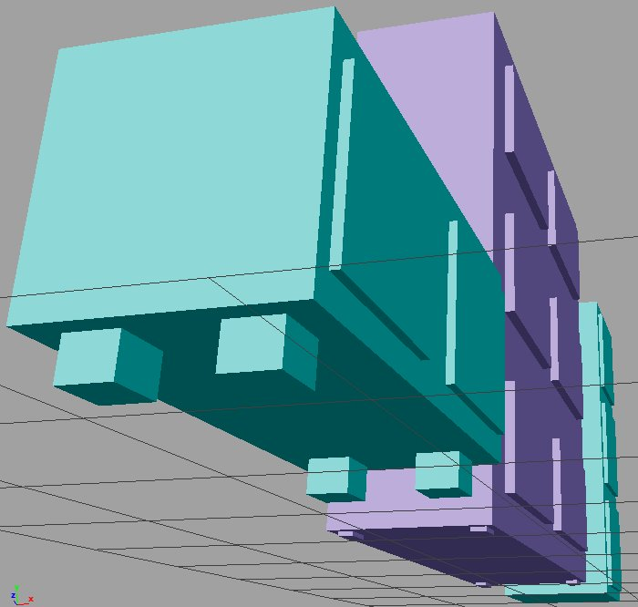
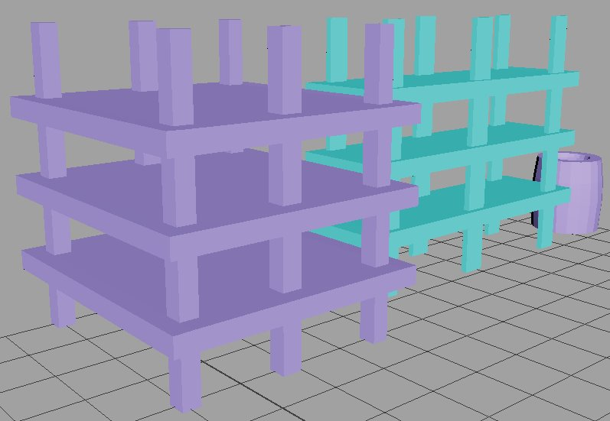
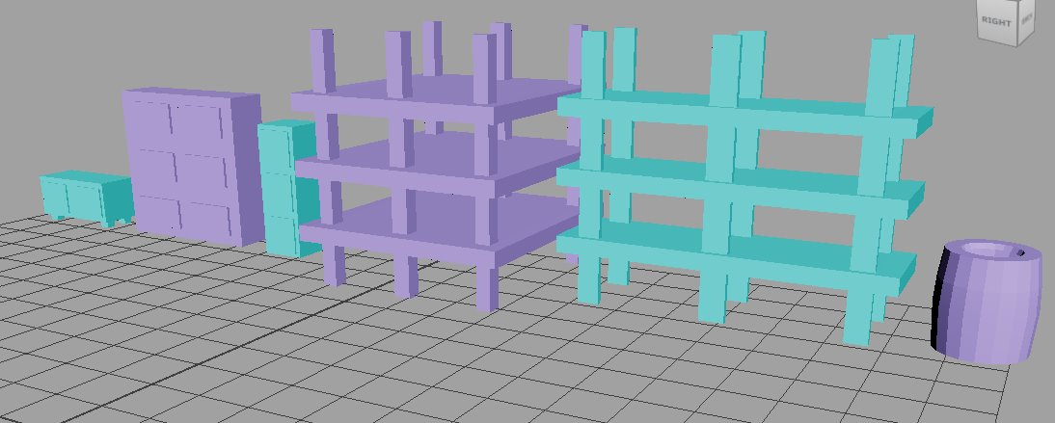
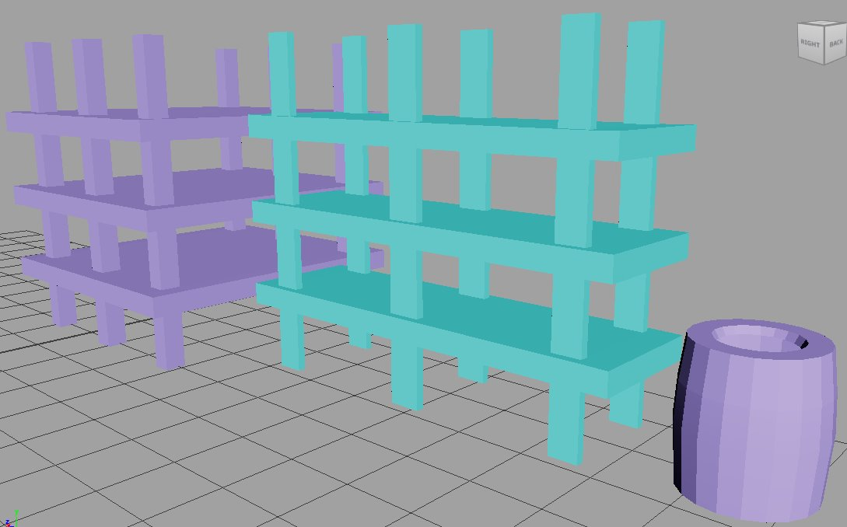
Environment – Basic Assets
Asset
Low Drawers
Double Cabinet
Filing Cabinet
Pallet
Thick Metal Pallet
Barrel

Slide 9
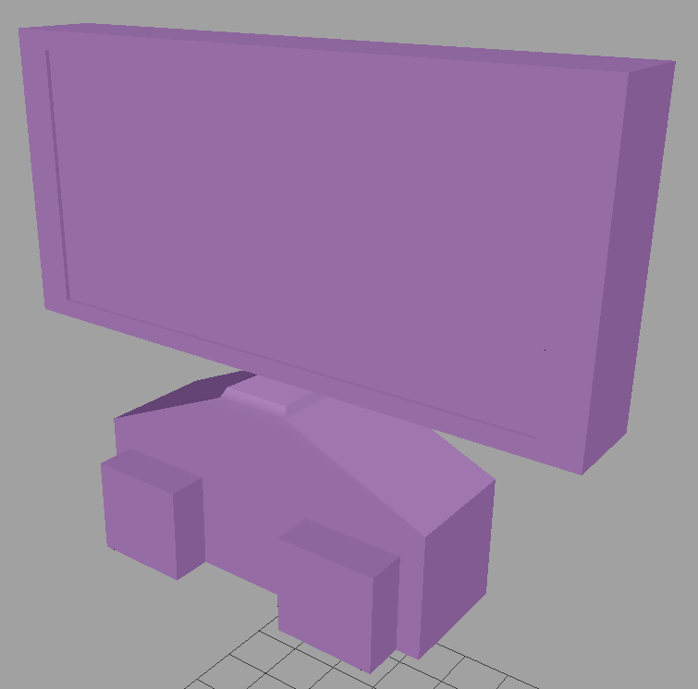
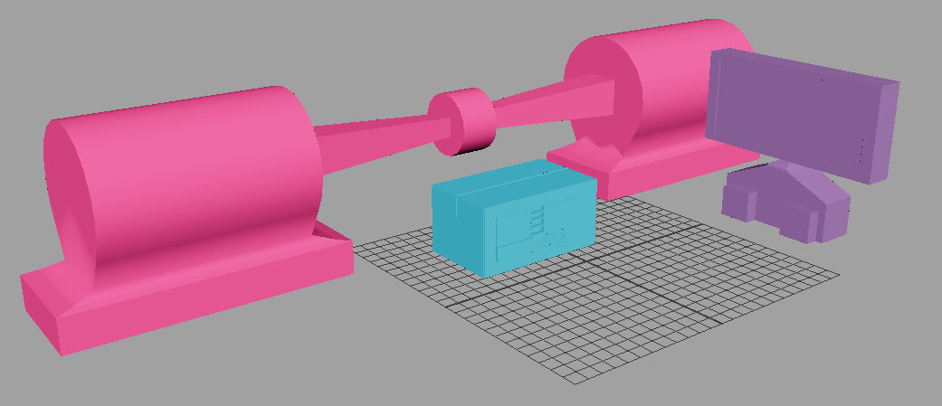
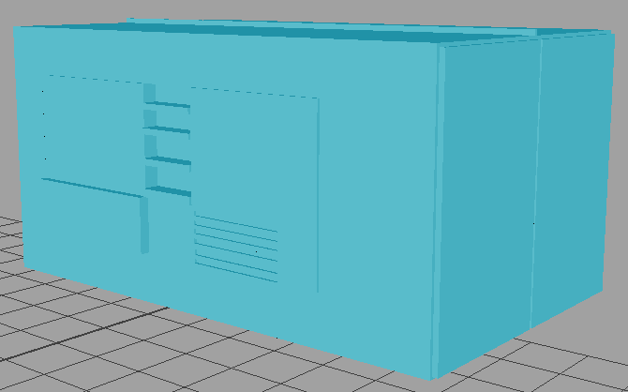
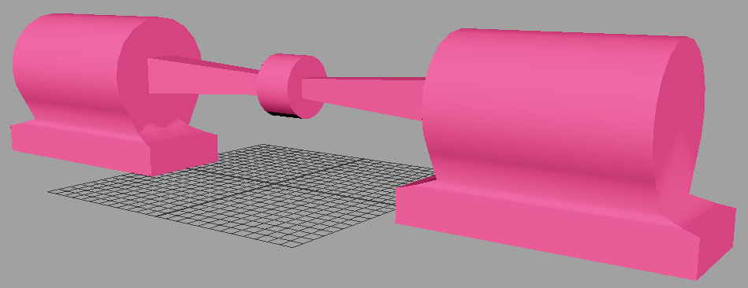
Generator Room Furniture

Slide 10
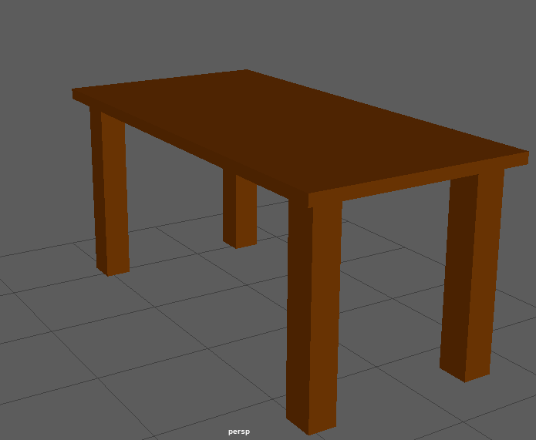
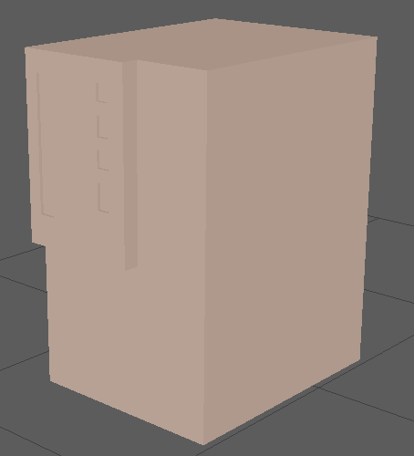
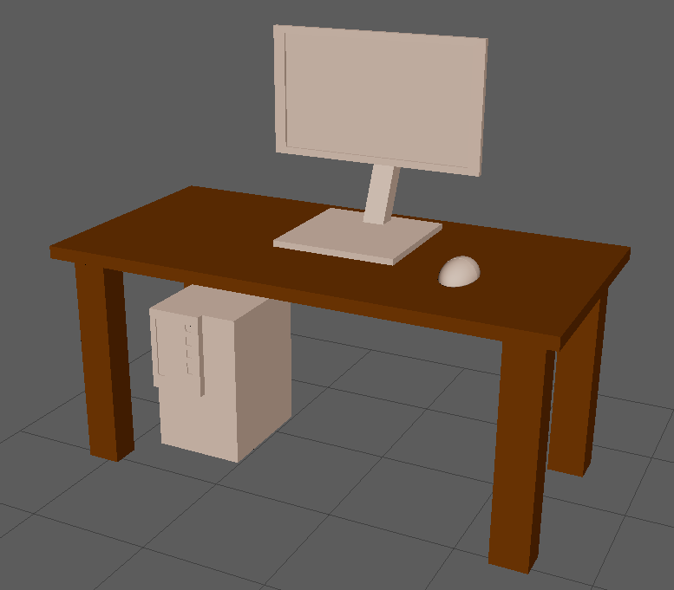
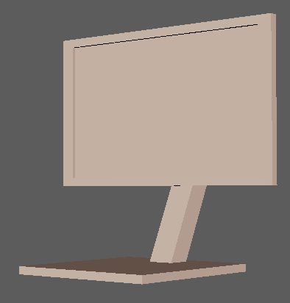
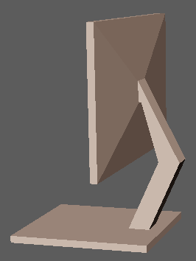
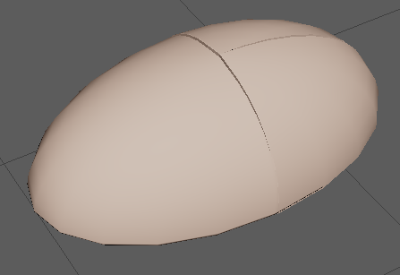
Office Furniture

Slide 11
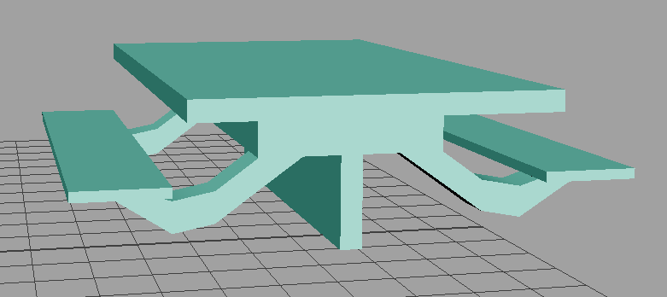
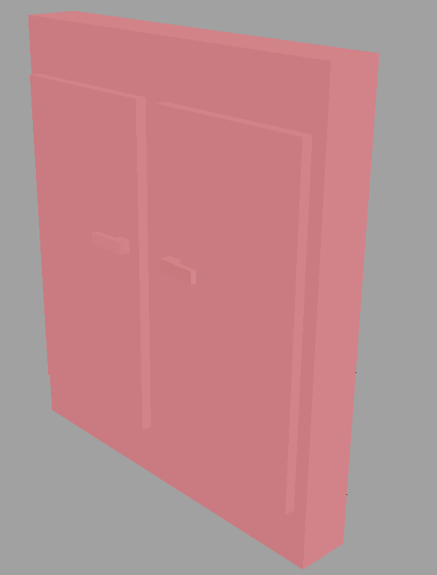
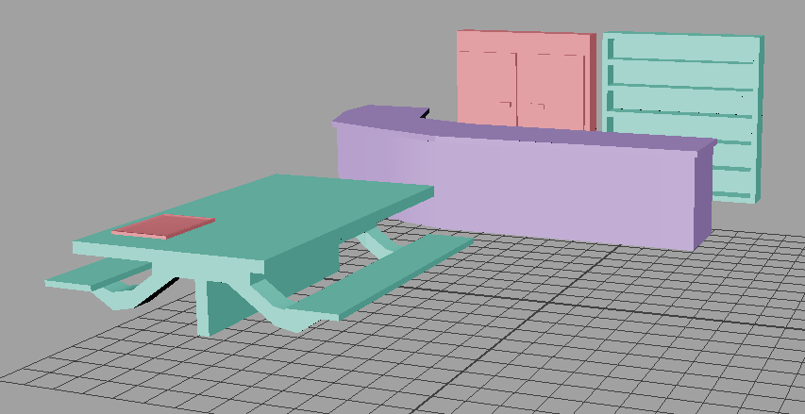
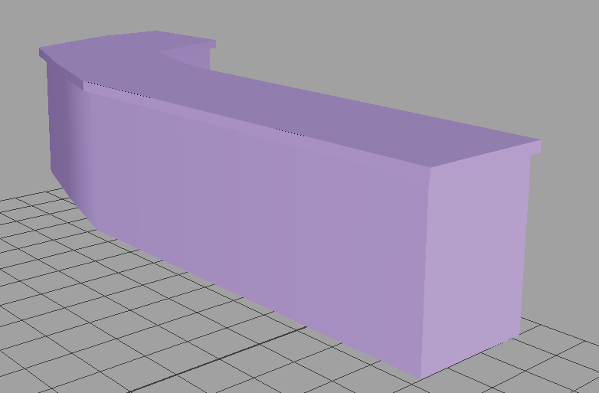
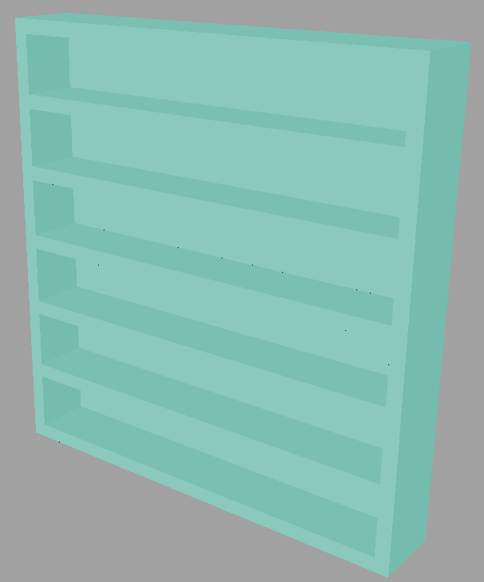
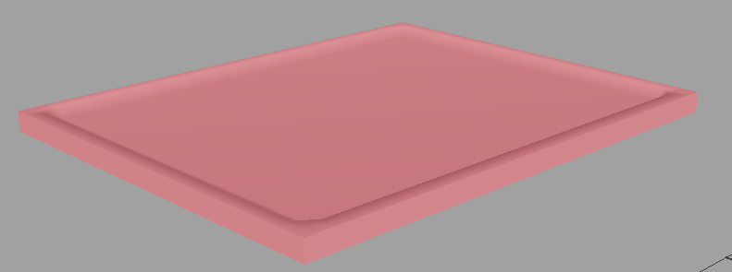
Cafeteria Furniture

Slide 12
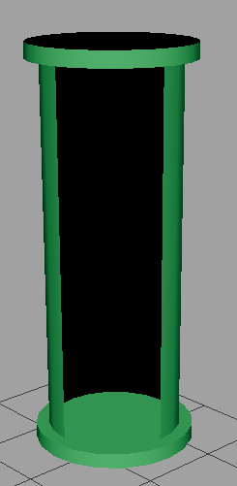
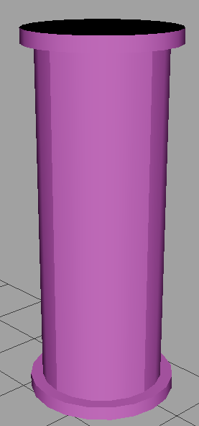
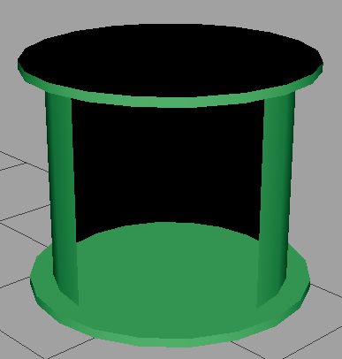
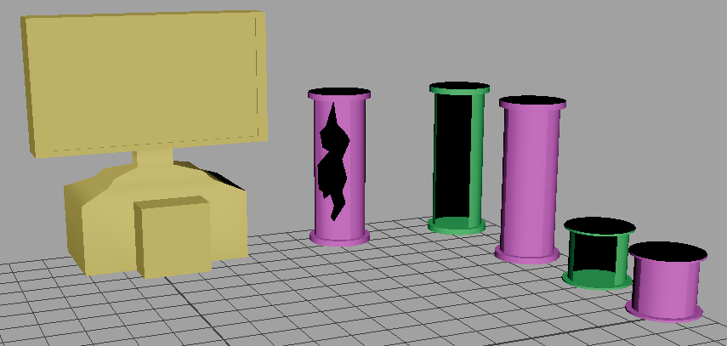
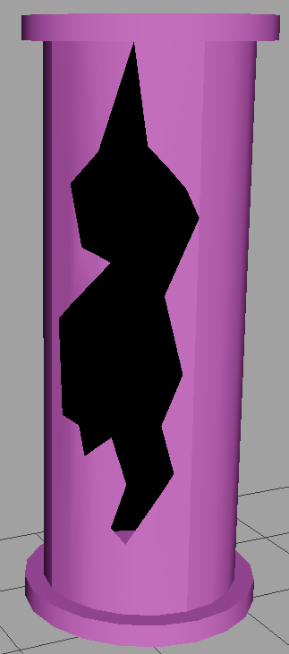
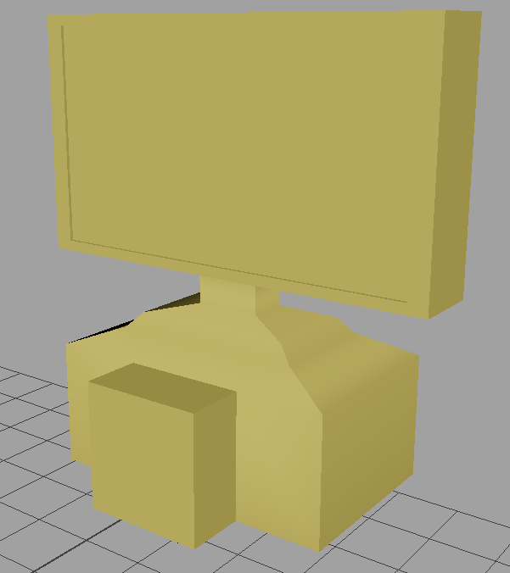
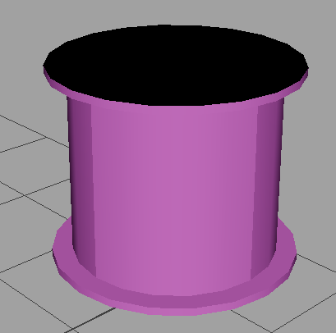
Experimental Lab Furniture

Slide 13
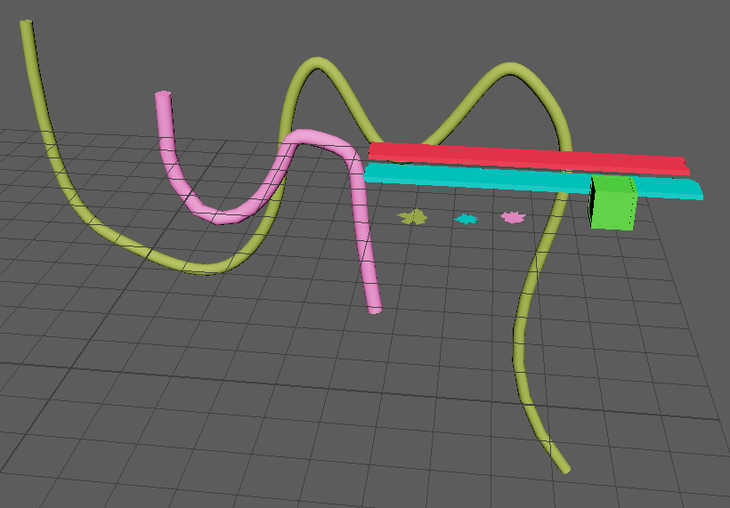








Miscellaneous Furniture

Slide 14

Characters

Slide 15

In game Mockup

Slide 16

Opening Cutscene Concept

